Slide 1
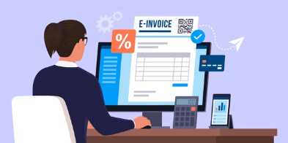



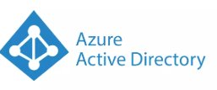


AGS Health – Expense submission
A global healthcare solutions powerhouse with over 12,000 employees, offering extensive services, including global revenue cycle management. They manage a significant amount of monthly expenses, including purchases, services, repairs, and other operational costs.
AGS Health engaged our team to develop an automated expense management solution to streamline their expense submission and approval process. The goal was to reduce manual effort, minimize errors, and improve efficiency in their billing across multiple locations.
Challenge
Benefits
Manual expense management using Excel sheets was inefficient and error-prone.
Consolidating data from multiple locations was challenging.
Delays in approvals and payments due to manual processes.
Frequent errors in invoice validation and cross-checking.
Reduced manual effort by 60-70%.
Decreased errors by up to 95%.
Improved efficiency with streamlined processes.
Enhanced accuracy in expense management.
Multi-level checking of invoices reduced discrepancies in billing numbers.
Solution
Developed an automated expense submission application.
Used AWS OCR for automated invoice data extraction.
Implemented multi-level approvals.
Included modules for invoice management, MRN, MSN, petty cash, credit card expenses, purchase orders, inventory management, vendor management, contract manpower, budget management, and provisions.
Centralized data management for easy access and oversight.
Technologies
Notes:
Is travel expense management a sub category within expense management – then we can combine
May be this is Accounts Payable management and not just. Expense management – Please check

